Slide 1
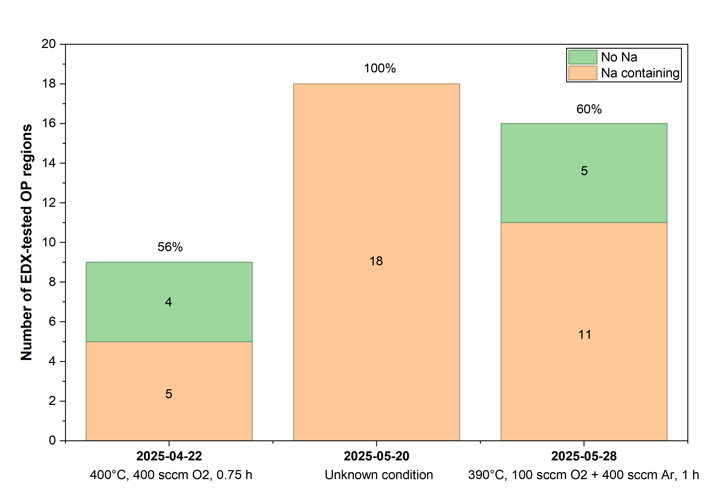
Statistics of Oh Junseok's EDX results
Date | Condition | Na-containing OP | No Na OP | Total tested points | Na-containing ratio
2025/04/22 | 400°C，400 sccm O₂，0.75 h | 5 | 4 | 9 | 56.0%
2025/05/20 | Unknown condition | 18 | 0 | 18 | 100.0%
2025/05/28 | 390°C，100 sccm O₂ + 400 sccm Ar，1 h | 11 | 5 | 16 | 68.8%
Stacked column chart

Slide 2
Histogram of Oh Junseok's EDX results

Slide 3
Distribution of my EDX results

